Slide 1
Views and Materialized Views

Slide 2
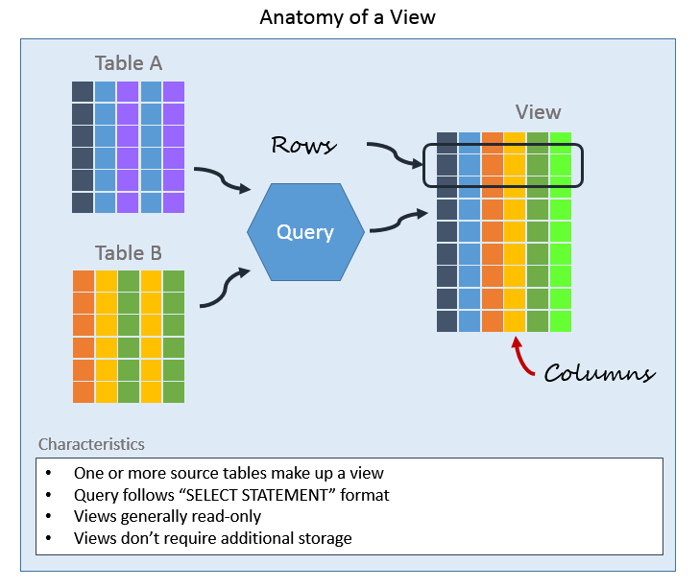
Views and Materialized Views
A View is a virtual table in SQL.
It is created by saving a SQL query.
Does not store data physically, only the query.
Acts like a table but pulls data from underlying tables.
Why Use Views?
Simplifies complex queries.
Provides data security by restricting column access.
Makes code reusable.
Presents data in a customized format.

Slide 3
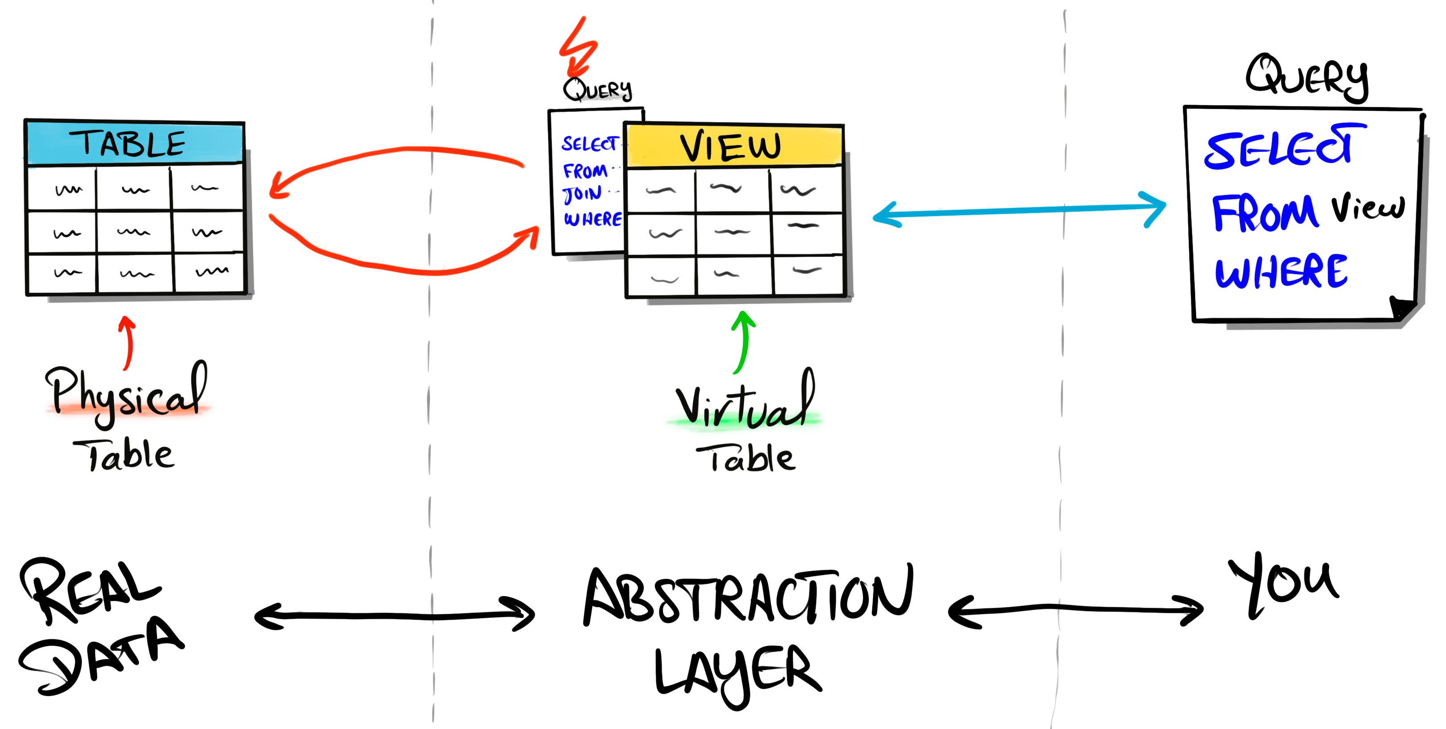
Views and Materialized Views
Creating a View
Using a View
CREATE VIEW view_name AS
SELECT column1, column2
FROM table_name
WHERE condition;
SELECT * FROM HighSalaryEmployees;
Always shows the latest data from the base tables.
Example:
CREATE VIEW HighSalaryEmployees AS
SELECT name, salary
FROM Employees
WHERE salary > 50000;

Slide 4
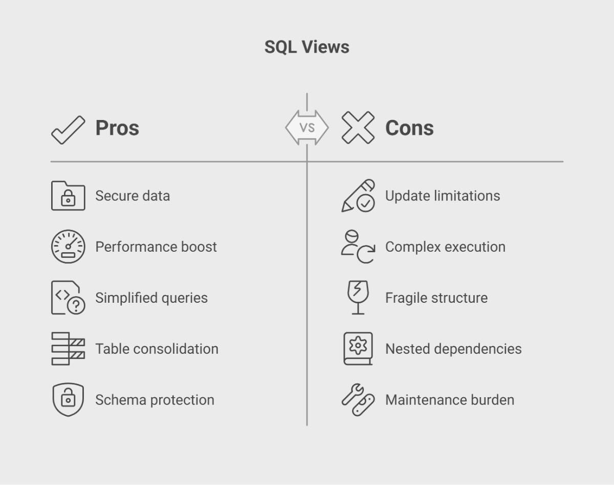
Views and Materialized Views
Advantages of Views
Simplifies access to complex queries.
Provides abstraction of the database schema.
Enhances security (restricts sensitive data).
Easy maintenance and reuse.
Limitations of Views
Slower for complex queries (executes each time).
Cannot always perform DML (INSERT, UPDATE, DELETE).
No physical storage (only virtual).

Slide 5
Views and Materialized Views
Types of Views
Simple View – based on one table.
Complex View – based on multiple tables with joins.
Inline View – subquery in the FROM clause.
Example of Complex View
CREATE VIEW EmployeeDept AS
SELECT e.name, e.salary, d.dept_name
FROM Employees e
JOIN Departments d
ON e.dept_id = d.dept_id;
Example of Inline View
SELECT dept_name, AVG(salary) AS avg_salary
FROM (
SELECT e.name, e.salary, d.dept_name
FROM Employees e
JOIN Departments d
ON e.dept_id = d.dept_id
) AS Temp
GROUP BY dept_name;

Slide 6
Views vs Materialized Views
Feature | View (Virtual View) | Materialized View (Stored View)
Definition | Virtual table created from a SQL query | Physical table storing query results
Storage | No physical storage (only query definition) | Occupies physical storage (stores data)
Data Freshness | Always up-to-date (fetches from base table) | May become outdated (needs refresh)
Speed | Slower (executes query every time) | Faster (data pre-stored)
Maintenance | No refresh needed | Needs manual or automatic refresh
Use Case | For real-time, always accurate data | For performance improvement on large queries
DML Support | Sometimes updatable (depends on query) | Not directly updatable (needs refresh)
Performance | Depends on base query complexity | Optimized for faster retrieval
Best For | Security, abstraction, simple queries | Heavy aggregations, reporting, big datasets

Slide 7
Stored Procedures and Functions

Slide 8
Stored Procedures
A Stored Procedure is a precompiled collection of one or more SQL statements. It is stored inside the database and executed when called. It Helps in reusability, performance, and security.
Features of Stored Procedures
Encapsulates SQL logic in a single unit.
Can accept parameters (IN, OUT, INOUT).
Improves performance (compiled once, executed many times).
Provides security by restricting direct access to tables.
Supports error handling.
Syntax:
CREATE PROCEDURE procedure_name (parameters)
AS
BEGIN
-- SQL statements
END;
Calling:
EXEC procedure_name;
-- or
CALL procedure_name;

Slide 9
Stored Procedures
Example of Stored Procedure
Stored Procedure with Parameters
CREATE PROCEDURE GetEmployees
AS
BEGIN
SELECT * FROM Employees;
END;
CREATE PROCEDURE GetEmployeeById
@EmpId INT
AS
BEGIN
SELECT * FROM Employees WHERE EmployeeID = @EmpId;
END;
Execution:
Execution:
EXEC GetEmployees;
EXEC GetEmployeeById 101;

Slide 10
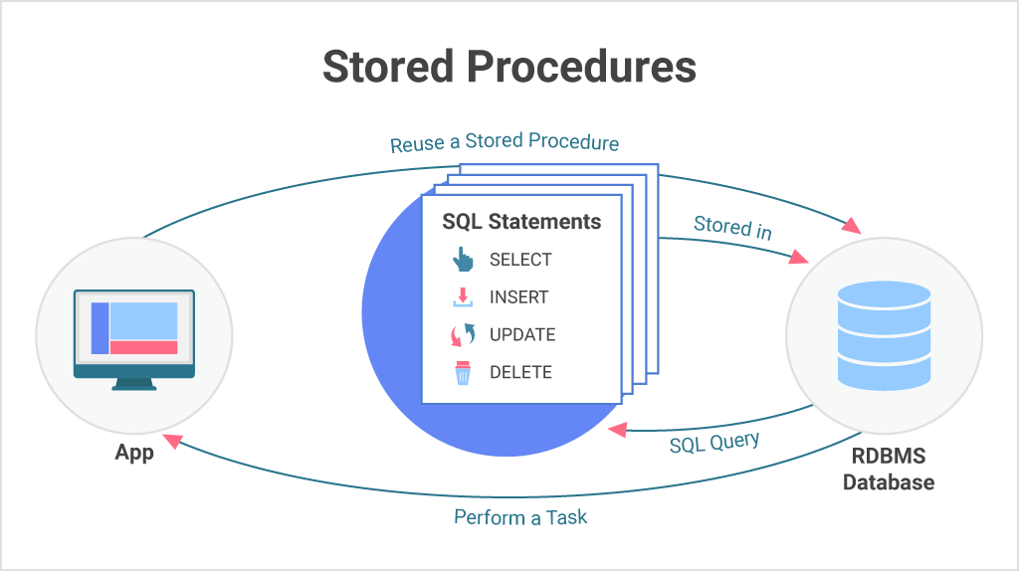
Stored Procedures
Advantages of Stored Procedures
Reusability – write once, use many times.
Improved Performance – reduces query parsing time.
Security – prevents SQL injection, hides schema.
Maintainability – easy to update logic in one place.
Disadvantages of Stored Procedures
Harder to debug and test compared to application code.
Portability issues (different databases have different syntax).
Can cause complexity if not organized well.
May increase server load if overused
Use Cases of Stored Procedures
Data validation before insertion.
Automating repetitive tasks (e.g., monthly reports).
Complex business logic implementation.
Securing sensitive data

Slide 11
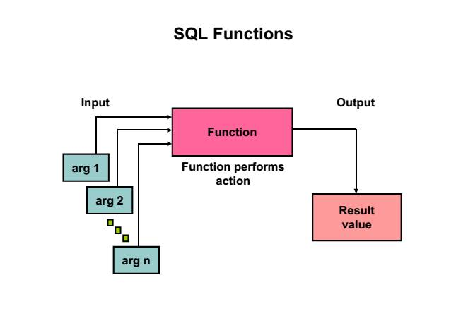
Functions
A Function is a database object that performs a task and returns a value. It is used for calculations, transformations, and data manipulation. It can be system-defined or user-defined.
Types of SQL Functions:
System Functions – provided by the database (e.g., LEN, GETDATE, ROUND).
User-Defined Functions (UDFs) – created by users for specific tasks.
Scalar Functions – return a single value.
Table-Valued Functions – return a table.
Syntax:
CREATE FUNCTION function_name (@parameter datatype)
RETURNS datatype
AS
BEGIN
-- function logic
RETURN value;
END;

Slide 12
Functions
Example of Scalar Function
Example of Table-Valued Function
CREATE FUNCTION GetAnnualSalary (@MonthlySalary DECIMAL)
RETURNS DECIMAL
AS
BEGIN
RETURN (@MonthlySalary * 12);
END;
CREATE FUNCTION GetHighSalaryEmployees (@MinSalary DECIMAL)
RETURNS TABLE
AS
RETURN
SELECT name, salary
FROM Employees
WHERE salary > @MinSalary;
Usage:
Usage:
SELECT dbo.GetAnnualSalary(30000) AS AnnualSalary;
SELECT * FROM dbo.GetHighSalaryEmployees(50000);

Slide 13
Functions
Advantages | Limitations
Promotes reusability – can be used multiple times in queries | Cannot perform INSERT, UPDATE, DELETE directly
Simplifies complex calculations | Cannot handle transactions (BEGIN, COMMIT, ROLLBACK)
Improves readability and modularity | Execution may be slower for complex logic
Can be used inside SELECT, WHERE, GROUP BY, HAVING clauses | Functions cannot call stored procedures
Provides consistency – same logic used everywhere | Limited to returning a value or table only
Enhances security – hides business logic from users | Some functions (especially scalar) may reduce query performance in large datasets

Slide 14
Triggers

Slide 15
Triggers
A trigger is a stored program in the database. It is executed automatically when a specific event (INSERT, UPDATE, DELETE) occurs on a table or view. t is used for enforcing business rules, maintaining audit trails, and data validation.
Types of TRIGGERS:
BEFORE Trigger – Executes before the event occurs.
AFTER Trigger – Executes after the event occurs.
INSTEAD OF Trigger – Executes instead of the triggering action (mostly on views).
Trigger Events:
INSERT Trigger → Fires when new data is inserted.
UPDATE Trigger → Fires when data is modified.
DELETE Trigger → Fires when data is deleted.

Slide 16
Triggers
CREATE TRIGGER trigger_name
This creates a new trigger.
(trigger_name is the name you give to your trigger (example: trg_SalaryUpdate).)
ON table_name
The table on which the trigger will work.
Example: ON Employees.
AFTER | BEFORE | INSTEAD OF
AFTER → Runs after the operation happens (most common).
BEFORE → Runs before the operation happens (not in all SQL databases).
INSTEAD OF → Replaces the actual operation (mostly used with views).
[INSERT, UPDATE, DELETE]
Defines the event that fires the trigger:
  INSERT → when a new row is inserted.
  UPDATE → when existing data is changed.
  DELETE → when a row is deleted.
AS
Keyword that begins the trigger body (the code inside).
BEGIN … END
The block of SQL statements that will run automatically when the trigger fires.
Syntax:
CREATE TRIGGER trigger_name
ON table_name
AFTER | BEFORE | INSTEAD OF
[INSERT | UPDATE | DELETE]
AS
BEGIN
-- SQL statements
END;

Slide 17
Triggers
Example:
CREATE TRIGGER trg_AddEmployeeLog
ON Employees
AFTER INSERT
AS
BEGIN
PRINT 'A new employee has been added!';
END;
How It Works
Step 1: User inserts a new row into Employees table
↓
Step 2: Trigger trg_AddEmployeeLog fires automatically
↓
Step 3: Message displayed → "A new employee has been added!"
Explanation:
Runs after INSERT on Employees table.
Automatically executes the code inside.
Here it simply shows a message.

Slide 18
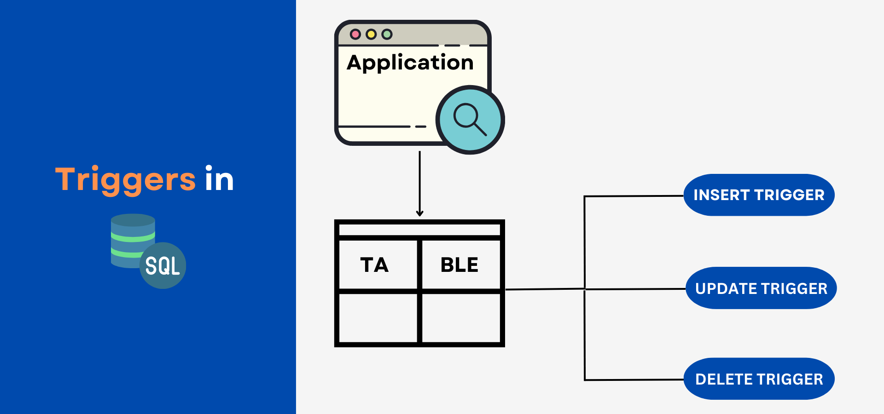
Triggers
Advantages of Triggers
Automatic execution (no manual intervention).
Ensures data integrity and consistency.
Useful for auditing and logging.
Can enforce complex business rules.
Limitations of Triggers
Can make debugging difficult.
May slow down performance if overused.
Hidden execution (not always visible to application).
Not suitable for complex business logic.
Use Cases of Triggers
Auditing changes in sensitive tables.
Enforcing security rules.
Maintaining history of transactions.
Preventing invalid data entry.

Slide 19
Indexes and Performance Tuning in SQL

Slide 20
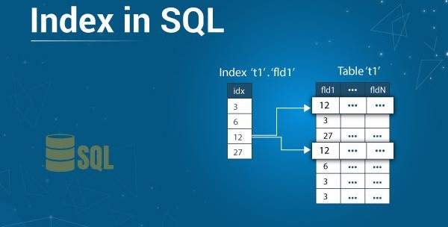
Indexes and Performance Tuning in SQL
An index is like a book index, helps to quickly locate data. It is created on table columns to speed up search and retrieval. Without an index SQL scans the entire table but with an index SQL directly jumps to the matching rows.
Types of Indexes
Clustered Index
Data is physically stored in order of index.
Only one clustered index per table.
Non-Clustered Index
Separate structure storing pointers to actual data.
Multiple non-clustered indexes allowed.
Unique Index – Ensures no duplicate values.
Composite Index – Index on multiple columns.
Full-Text Index – For searching words in large text columns.

Slide 21
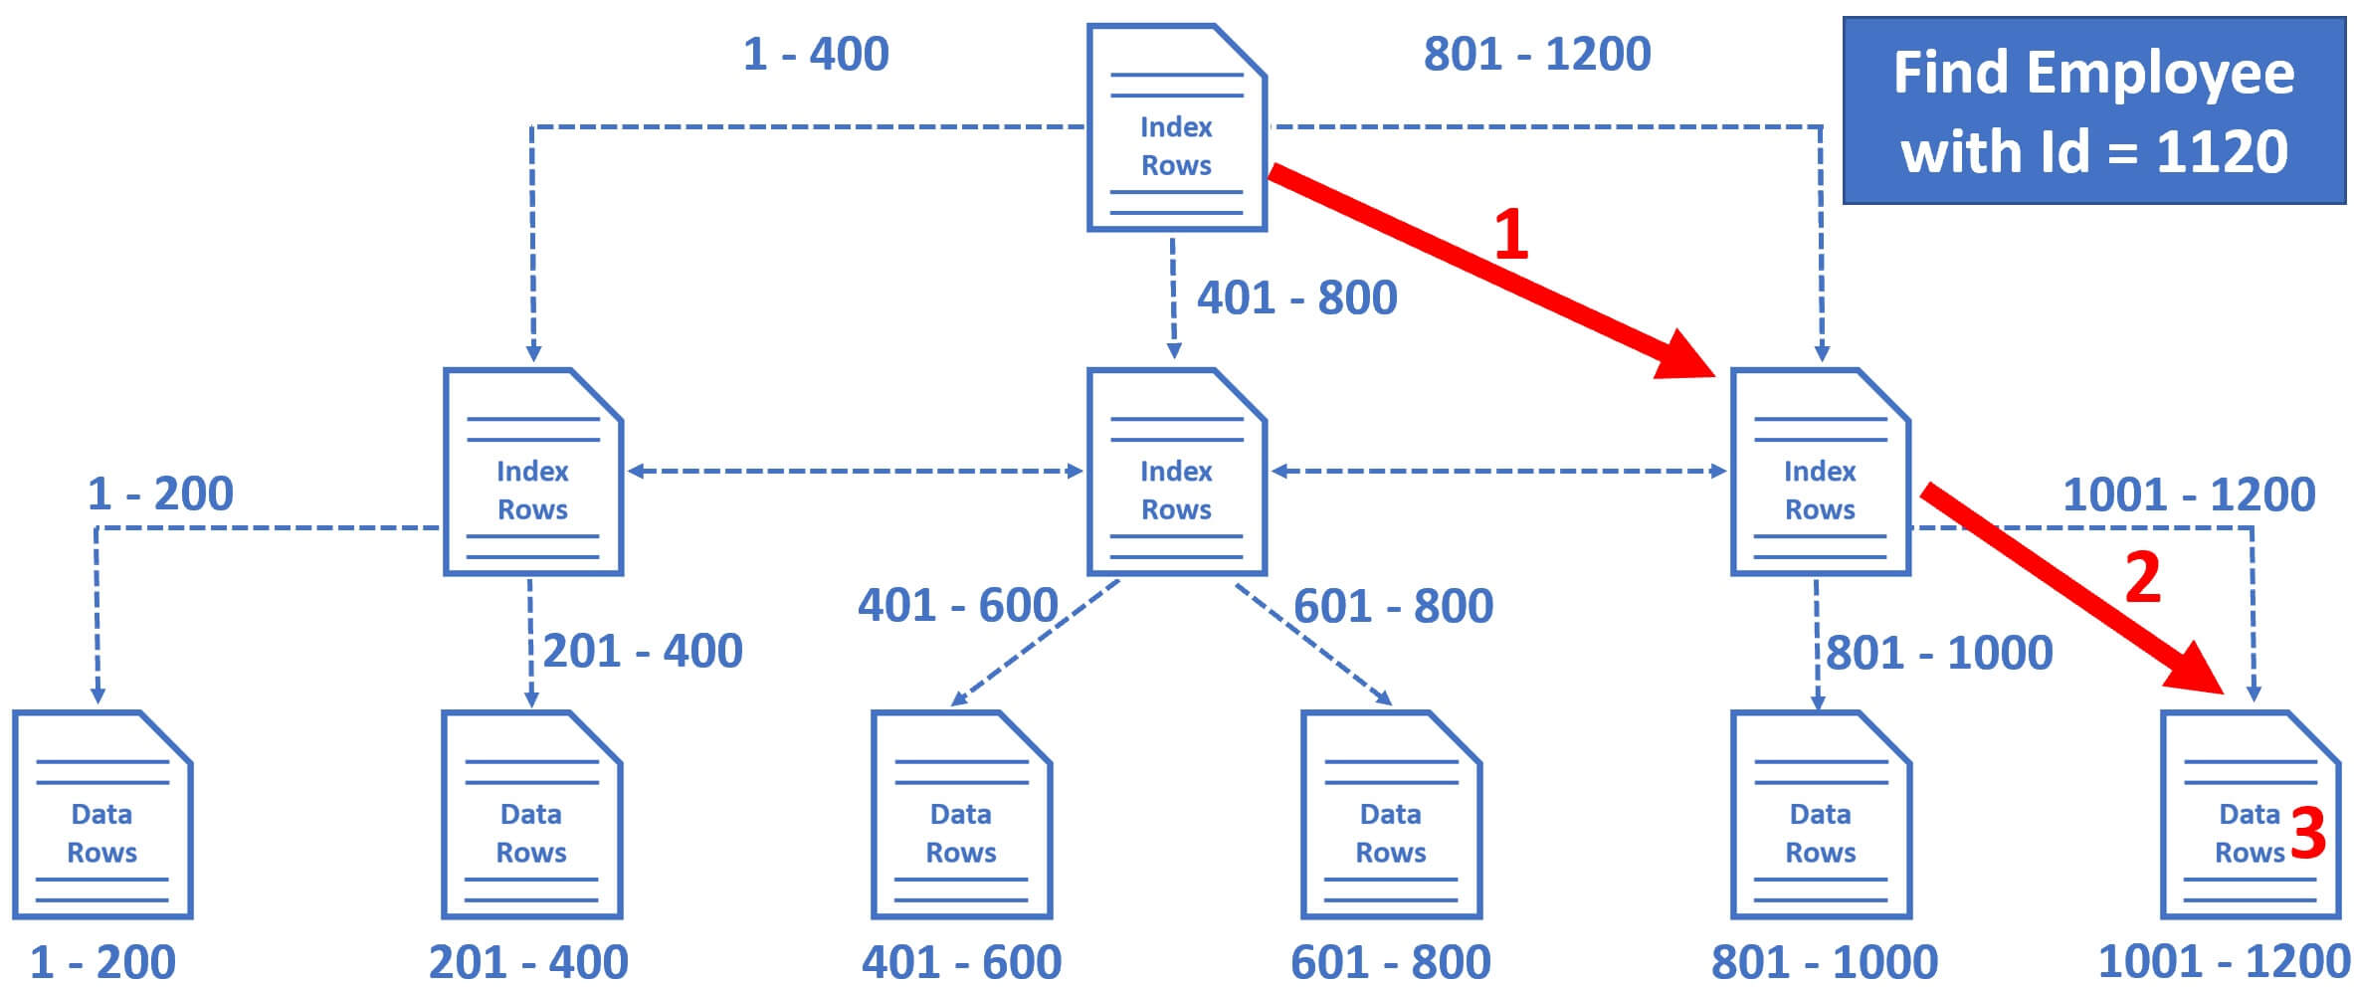
Indexes and Performance Tuning in SQL
Syntax:
CREATE INDEX index_name
ON table_name (column_name);
Drop Index:
DROP INDEX index_name ON table_name;
Index Usage Example
-- Query without index
SELECT * FROM Employees WHERE Id = 1120;
-- Full table scan (slow)
-- Query with index
CREATE INDEX idx_emp_name ON Employees(Id);
SELECT * FROM Employees WHERE Id = 1120;
-- Uses index (fast)

Slide 22
Indexes and Performance Tuning in SQL
Advantages of Indexes
Faster SELECT queries.
Improves JOIN performance.
Helps in ORDER BY, GROUP BY queries.
Ensures uniqueness (unique index).
Limitations of Indexes
Slows down INSERT, UPDATE, DELETE (because index must be updated).
Takes extra storage space.
Too many indexes can hurt performance.

Slide 23
Indexes and Performance Tuning in SQL
Performance Tuning Techniques
Use Indexes wisely (on frequently searched columns).
Avoid SELECT * → fetch only needed columns.
Use Joins properly instead of subqueries.
Normalize tables (reduce redundancy).
Partition large tables for faster access.
Update statistics regularly so optimizer works better.
Use Execution Plans to analyze slow queries.

Slide 24
Real World Performance Challenges

Slide 25
Real World Performance Challenges
SQL databases face many real-world performance challenges when handling large data, high traffic, or complex queries. Here are the major ones explained in simple points:
Queries that take too long to run because of:
Poor indexing
Too many joins
Using SELECT * instead of selecting only needed columns
Filtering on non-indexed columns
Slow Queries:
Poor Indexing:
Missing indexes → full table scans (very slow).
Too many indexes → slows down INSERT, UPDATE, DELETE.
Wrong type of index (e.g., B-tree vs bitmap) → bad performance.

Slide 26
Real World Performance Challenges
High Concurrency (Many Users at Once):
Multiple users accessing the same database can cause:
Locking (one transaction blocks another)
Deadlocks (two transactions wait forever for each other)
Contention (too many people updating same table/row)
Large Data Volume:
As tables grow into millions of rows:
  Queries become slower.
  Backups and restores take more time.
  Joins across large tables become very costly.
Poor Query Design:
It includes the following:
Using subqueries instead of joins (or vice versa).
No proper filtering (missing WHERE).
Repeated queries instead of caching results.
Not using pagination (LIMIT, OFFSET) for large result sets.

Slide 27
Real World Performance Challenges
Joins Across Huge Tables:
Joining many big tables can cause:
  High memory usage
  Slow response time
  Temporary tables (disk I/O overhead)
Inefficient Transactions:
It includes the following:
Long transactions → lock rows/tables for long time.
Unnecessary rollbacks → waste resources.
Not committing quickly → delays for others.
Hardware & Resource Bottlenecks:
It includes the following:
CPU overload when queries are complex.
Not enough RAM → queries spill to disk (slower).
Slow disk I/O → especially for large reads/writes.

Slide 28
Real World Performance Challenges
It includes the following:
Bad Schema Design:
Not normalized → redundant data → storage & performance issues.
Over-normalized → too many joins → query slowdown.
No partitioning/sharding → large tables hard to query.
Network Latency:
It includes the following:
If application and database are on different servers.
Too many round-trips between app and DB.
It includes the following:
Lack of Query Optimization:
Not analyzing execution plan.
Not rewriting queries in efficient way.
Not using database-specific optimization features (like query hints).

